Slide 1



Spoke-Darts for High-Dimensional Blue-Noise Sampling
Scott A. Mitchell ACM TOG 37:2, May 2018 Scott A. Mitchell, Mohamed S. Ebeida, Muhammad A. Awad, Chonhyon Park, Anjul Patney, Ahmad A. Rushdi, Laura P. Swiler, Dinesh Manocha (now UMD), Li-Yi Wei
SIGGRAPH 2018 18 minutes talk 15 Aug 10:45 am session talk 4 West Building, Room 109-110
Notes:
Scott Mitchell
Title
From CCR
Thank partners, especially Li-Yi

Slide 2
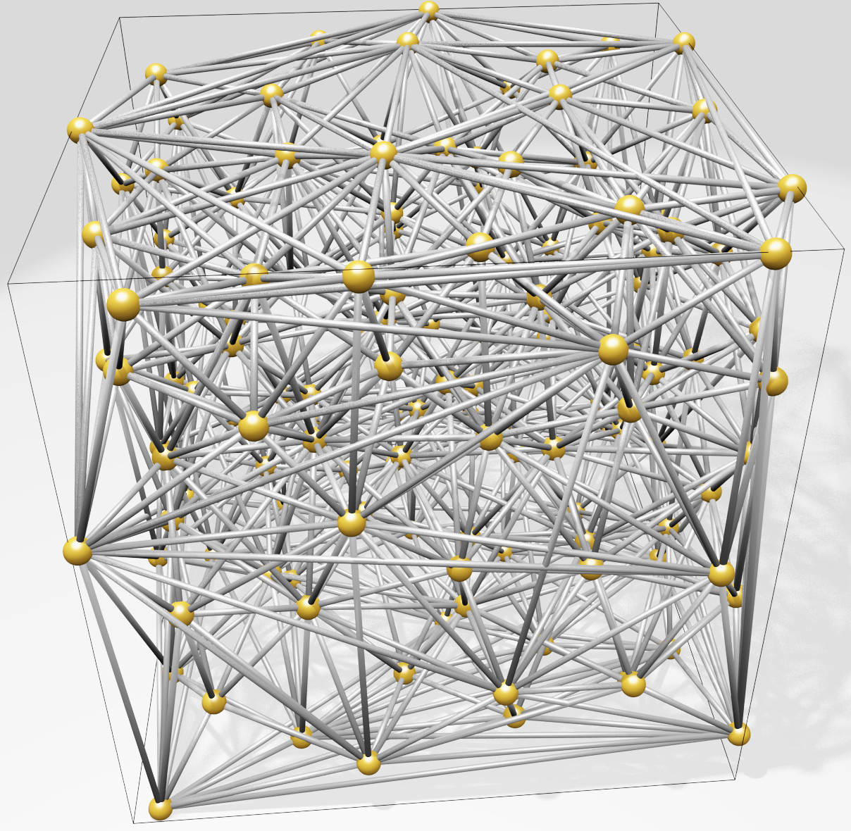
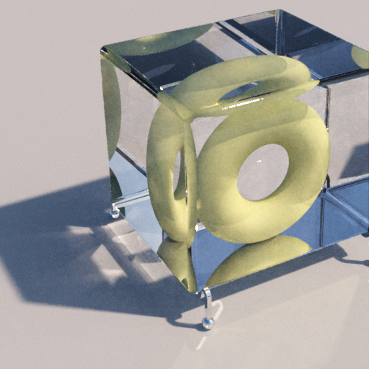
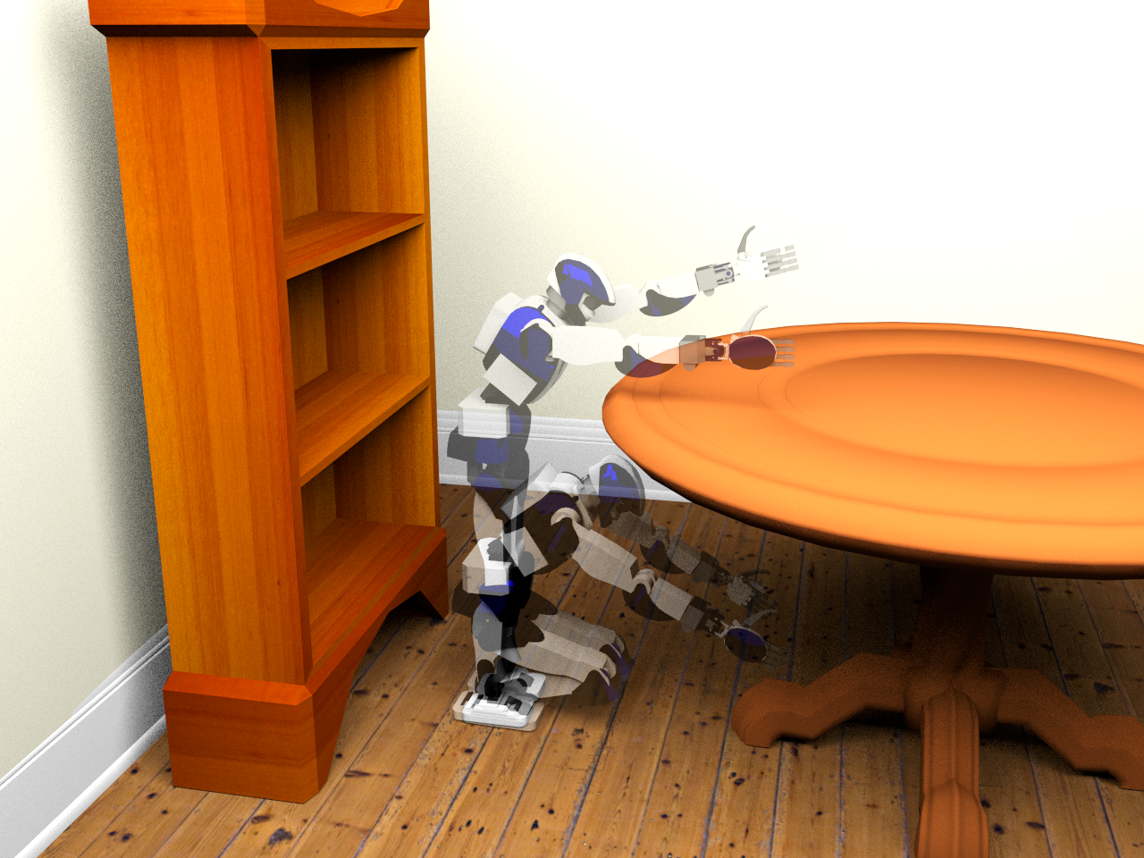
Motivation
High-dimensional blue-noise sampling is useful but hard to generate
Render
Geometry
8-100D: approximate Delaunay Graphs (Voronoi neighbors)
8D: proof-of-concept path tracing
Social proof of utility: Bridson SIGGRAPH 2007 cited 200 times
23D: find a path in robot configuration space
Motion Plan
Optimize
100D: adaptively explore black-box function to find global minimum
Notes:
why would you want high-d blue noise?
in paper, demo apps ...
evidence or relevance I'm most interested in is attention given to prior solution, 1 page SIGGRAPH sketch 10 years ago
clear improvement : discovered output flaws, fixed, and provided guarantees

Slide 3
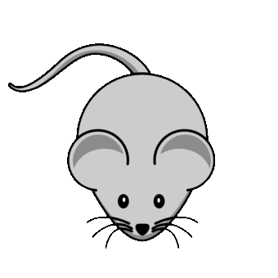

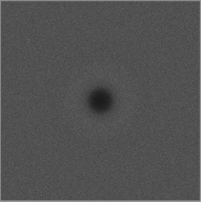
Motivation
Maximum
domain-to-sample distance
Goal: algorithm to produce point distributions
Requirements
Output: blue-noise, uniform-random point distribution except
No points too close
No big gaps
Process
Memory & time scales to high dimensions (e.g. 20D)
Locally adaptive, general domain shapes
Confidence: provable guarantees on output quality
Goal: algorithm to produce point distributions
Requirements
Output: blue-noise, uniform-random except
No points too close
No big gaps
Process
Memory & time scales well to high dimensions (e.g. 20D)
Locally adaptive, general domain shapes
Confidence: provable guarantees on output quality
Goal: algorithm to produce point distributions
Requirements
Output: blue-noise, uniform-random point distribution except
No points too close
No big gaps
Process
Memory & time scales well to high dimensions (e.g. 20D)
Locally adaptive, general domain shapes
Confidence: provable guarantees on output quality
Goal: algorithm to produce point distributions
Requirements
Output: blue-noise, uniform-random point except
No points too close
No big gaps
Process
Memory & time scales well to high dimensions (e.g. 20D)
Locally adaptive, general domain shapes
Confidence: provable output quality
Minimum sample separation
RP Radial Power
RDF Radial Distance Function

Slide 4
What’s wrong with the algorithms we already have?
SimpleMPS guarantees saturation
runtime & memory
divide domain into cubes while ∃cubes, and cube diagonal > machine precision do (A(d) × #cubes) times: pick a cube pick sample from cube if distance(sample, prior samples) > r accept sample discard cube refine cubes discard covered cubes
darts
refine
darts
refine
SimpleMPS, “A Simple Algorithm for Maximal Poisson-Disk Sampling in High Dimensions,” Eurographics 2012.
Notes:
simple mps
saturation
runtime
describe algorithm
what's not to love?

Slide 5
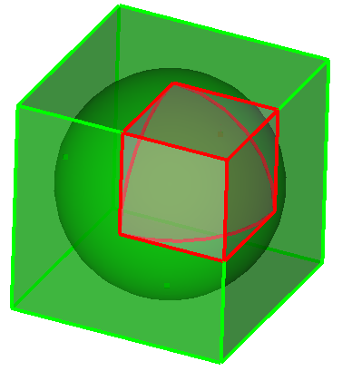
What’s wrong with the algorithms we already have?
SimpleMPS guarantees saturation … but doesn’t scale by dimension, d. ☹
runtime & memory
Problem: cube poorly approximates sphere Exponentially worse as dimension increases More empty boxes, memory limit d≈6
darts
…
refine
d=1
V(cube) = 1
V(sphere) = 1
d=2
V(cube) = 1
V(sphere) = 0.785…
d=3
V(cube) = 1
V(sphere) = 0.523…
d→∞
V(c) = 1
V(s) → 0
darts
Any algorithm that constructs (an approximation of) remaining sample space is doomed to be exponential-in-d
refine
SimpleMPS, “A Simple Algorithm for Maximal Poisson-Disk Sampling in High Dimensions,” Eurographics 2012.
Notes:
doesn't scale with dimension
vanishingly poor time and memory as d increases

Slide 6
What’s wrong with the algorithms we already have?
Bridson 2007* scales
runtime & memory
do prior = randomly pop Front do pick sample from volume of (r,2r) annulus of prior if distance(sample, all samples) > r accept sample add sample to Front until 30 consecutive rejections until Front is empty
Bridson 2007* pseudocode
30+ depending on dimension
*Modified: no background grid, no exponential-in-d complexity.
Bridson 2007, "Fast Poisson disk sampling in arbitrary dimensions." SIGGRAPH '07 sketch.
Notes:
Here's one that scales
<click> to start animation
describe alg while animating

Slide 7
What’s wrong with the algorithms we already have?
Bridson 2007* scales … but doesn’t guarantee saturation ☹
runtime & memory
Trivial in one annulus
Unknown outside all annuli?
?
Bridson 2007, "Fast Poisson disk sampling in arbitrary dimensions." SIGGRAPH '07 sketch.
Notes:
no saturation guarantee

Slide 8
Proposed Spoke-Darts algorithm
Spoke-Darts scales
runtime & memory
do prior = randomly pop Front do pick sample from radial line through (r,2r) annulus of prior if distance(sample, all samples) > r accept sample add sample to Front until 12 consecutive rejections until Front is empty
Spoke-Darts mod from Bridson
O
12 same for all dimensions
Spoke-Darts for High-Dimensional Blue-Noise Sampling, TOG 72:2, SIGGRAPH 2018.
Notes:
Our solution is to replace point samples with line samples
<click> to start animation
anchor point
<click> continue

Slide 9
Proposed Spoke-Darts algorithm
Spoke-Darts scales … and guarantees saturation ☺
runtime & memory
Proved probabilistic bound outside all annuli!
!
Spoke-Darts for High-Dimensional Blue-Noise Sampling, TOG 72:2, SIGGRAPH 2018.
Notes:
what's so great about line samples?
enables proof of saturation

Slide 10
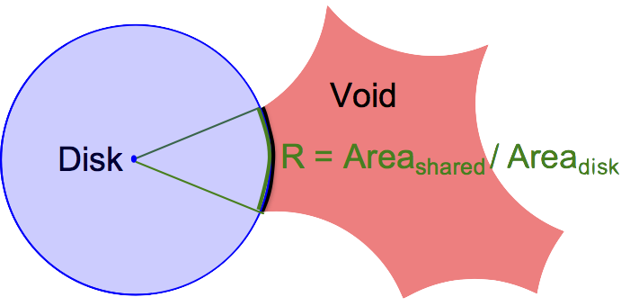
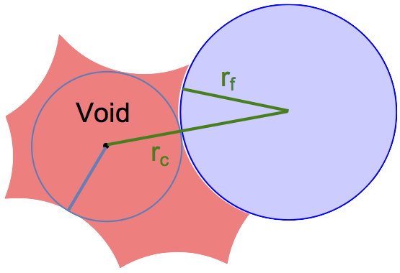
Suppose there exists a void
Proof of saturation
Spoke-Darts scales … and guarantees saturation
One disk
Missed 12 times, so area R is probably small, Probability of 12 misses = 𝝥(1-R) = (1-R)¹² < e^{(-12R)}
All disks Probability all missed = product of probabilities
p = 𝚷 e^{(-12 R_i)} = e^{-12 𝚺 R_i} p is small so sum of surface areas is small.
Small surface area → small void radius
No big gaps!
Notes:
proof sketch
consider void...
<click>
one disk touching void
<click>
all bounding disks - areas add up to still be small
<click>
small surface area -> small radius

Slide 11
Structure of saturation guarantee
Magic values for dimensional independence
e.g.
e.g.
where
chance beta exceeded
#misses, failed darts
dimension
pick any three
Notes:
explain structure, terms
Beta ratio of distances we talked about, domain pt to sample, sample to sample
m alg param
<click>
eps and m in proper ratio -> dimensional independence
<click>
m=12 works in paper
m=30, would take 3x longer, provide vanishingly small probability of large gaps

Slide 12
Output Saturation in Practice
Output Saturation in Practice,= better than Bridson
Bridson
one dimension “for free”
Theory: Beta = constant
Practice: Beta increases and narrows with d
Narrowing consistent with theory
Spoke-Darts
Spoke-Darts
dimension = 2
3
4
5
6
Bridson
Notes:
read
<click>
consistently better saturation, about one dimension for free

Slide 13
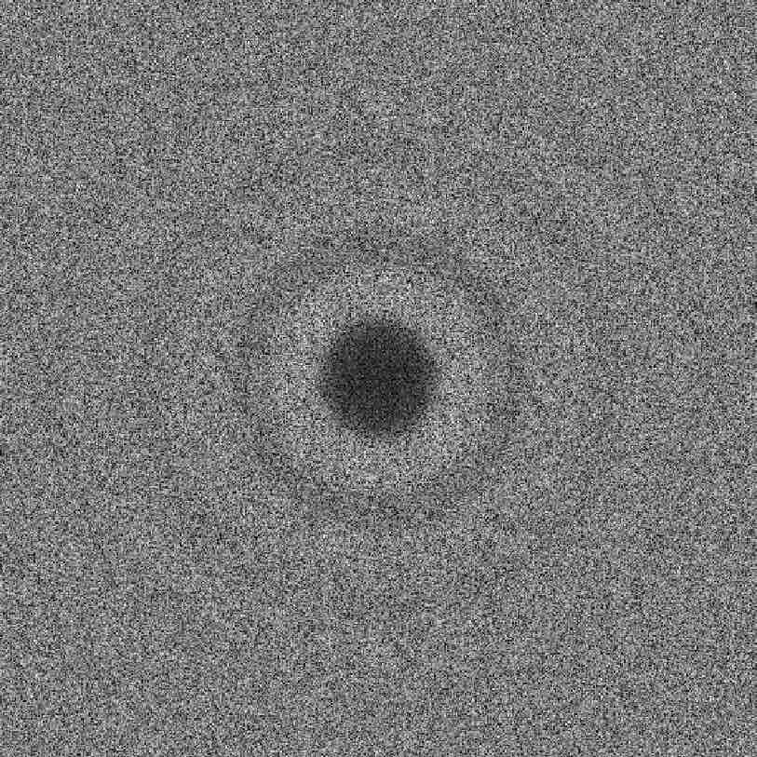
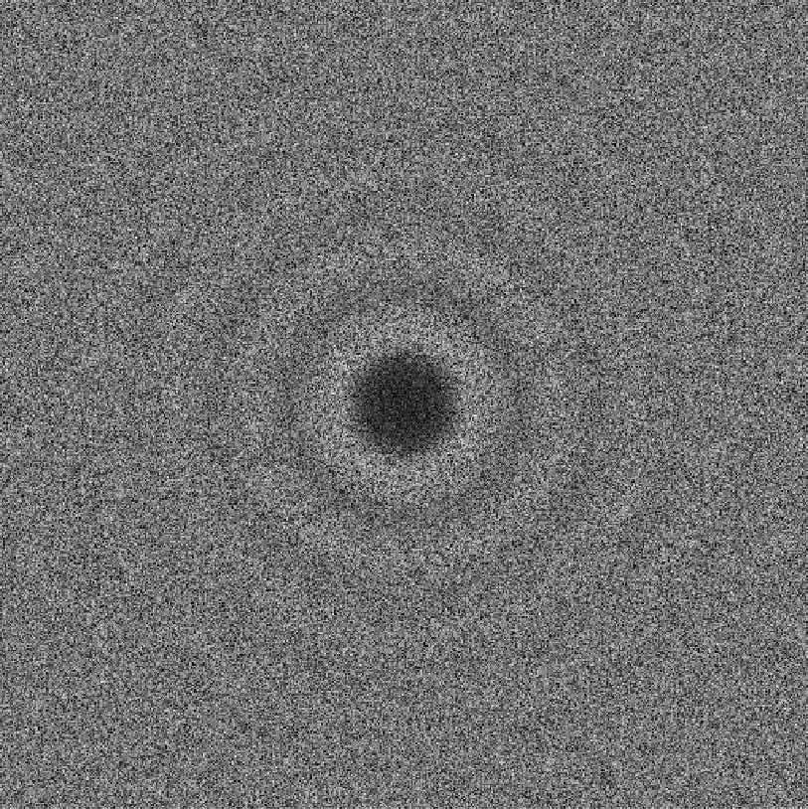
Output Randomness – Blue noise
Sharp spike at radius! (annuli inner-radius)
d=2
Dart Throwing
Spoke-Darts
Pairwise distances between samples
Bridson 2007
2nd discontinuity annuli outer-radius
RDF distances
Dart throwing images from
Blue Noise Sampling with Controlled Aliasing, TOG 32:3, 2013.
Fourier Transform, 1d integral over angle by radius
Fourier Transform
Notes:
Typical way to evaluate blue noise
rdf - explain
rp
spectrum
<click>
what in the world is this? They all have this spike. many more points are exactly r apart than you would expect from chance
Why would anyone want that?
Appears to be fundamental price for trying to achieve B=1
<click>
top it off, Bridson has a *second* discontinuity
yuck.

Slide 14
Output Randomness – Blue noise
Eliminate spike
Post-processing optimization* = expensive, 2d
Sample non-uniformly
By spoke-length? Uniform by swept volume? Worse!
Any sharp local rule → global discontinuity ☹
Spoke-Darts
RDF distances
Good idea
r_{free} maximum domain-point-to-sample distance
r_{conflict} minimum sample-to-sample distance
Bad idea
r_{free} = r_{conflict} ⟺ 𝜝=1
Traditional goal of Maximal Poisson-disk Sampling!
RP frequency
frequency
* Blue Noise Sampling with Controlled Aliasing, TOG 32:3, 2013.
Notes:
surely we can do better
read
one solution ...
I experimented with
<click>
let me be controversial for a moment
traditional goal is bad

Slide 15
Output Randomness – Blue noise
Eliminate spike – we solved in 2012 ☺
† Two-radii : r_{free} ≠ r_{conflict}
Small blue r_{free} minimum sample separation
Large green r_{conflict} maximum domain-to-sample
Unique coverage: accept only if covers white
Spoke-Darts
Two-spokes mimic Two-radii
RDF distances
accept, green covers some white
RP frequency
reject, inside a blue disk
reject, green already covered
frequency
† Variable Radii Poisson-Disk Sampling, Canadian Conf. on Comp. Geometry (CCCG) 2012.
Notes:
Actually I already fixed this 6 years ago, about d=5
but let me remind the Graphics Community
<click to appear and disappear each case>
non-unique coverage key difference with prior approaches
<click>
new solution for high-d
<click> each step of first pair of spokes
blue is small rconflict
red is large rfree
spoke from rfree, 2 rfree
temp sample S
*second* spoke +/-2(rfree - rconflict)
<click and just watch animation>

Slide 16
Output Randomness – Blue noise
Eliminate spike – we solved in 2012 ☺
† Two-radii : r_{free} ≠ r_{conflict}
Small blue r_{free} minimum sample separation
Large green r_{conflict} maximum domain-to-sample
Unique coverage: accept only if covers white
Spoke-Darts
Two-spokes mimic Two-radii
RDF distances
† Variable Radii Poisson-Disk Sampling, CCCG 2012.

Slide 17
Output Randomness – Blue noise
Eliminate spike – we solved in 2012 ☺
† Two-radii : r_{free} ≠ r_{conflict}
Small blue r_{free} minimum sample separation
Large green r_{conflict} maximum domain-to-sample
Unique coverage: accept only if covers white
Spoke-Darts
Two-spokes mimic Two-radii
RDF distances
† Variable Radii Poisson-Disk Sampling, CCCG 2012.

Slide 18
Output Randomness – Blue noise
Eliminate spike – we solved in 2012 ☺
† Two-radii : r_{free} ≠ r_{conflict}
Small blue r_{free} minimum sample separation
Large green r_{conflict} maximum domain-to-sample
Unique coverage: accept only if covers white
Spoke-Darts
Two-spokes mimic Two-radii
RDF distances
† Variable Radii Poisson-Disk Sampling, CCCG 2012.

Slide 19
Output Randomness – Blue noise
Eliminate spike – we solved in 2012 ☺
† Two-radii : r_{free} ≠ r_{conflict}
Small blue r_{free} minimum sample separation
Large green r_{conflict} maximum domain-to-sample
Unique coverage: accept only if covers white
Spoke-Darts
Two-spokes mimic Two-radii
RDF distances
† Variable Radii Poisson-Disk Sampling, CCCG 2012.

Slide 20
Output Randomness – Blue noise
Eliminate spike – we solved in 2012 ☺
† Two-radii : r_{free} ≠ r_{conflict}
Small blue r_{free} minimum sample separation
Large green r_{conflict} maximum domain-to-sample
Unique coverage: accept only if covers white
Spoke-Darts
Two-spokes mimic Two-radii
RDF distances
† Variable Radii Poisson-Disk Sampling, CCCG 2012.

Slide 21
Output Randomness – Blue noise
Eliminate spike – we solved in 2012 ☺
† Two-radii : r_{free} ≠ r_{conflict}
Small blue r_{free} minimum sample separation
Large green r_{conflict} maximum domain-to-sample
Unique coverage: accept only if covers white
Spoke-Darts
Two-spokes mimic Two-radii
RDF distances
† Variable Radii Poisson-Disk Sampling, CCCG 2012.
Notes:
what we get is

Slide 22
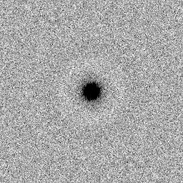
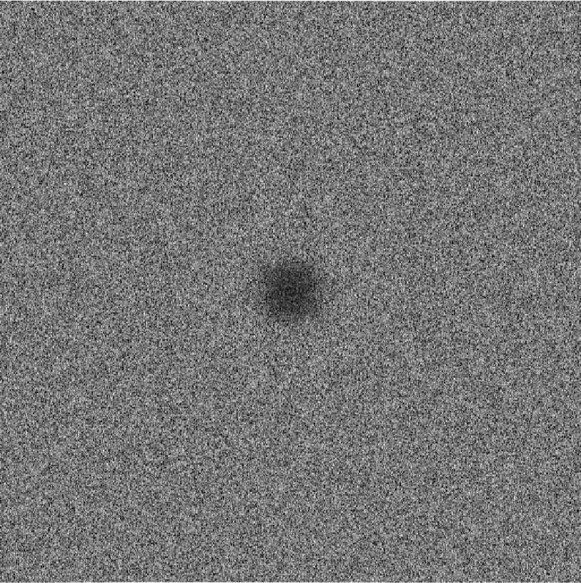
Output Randomness – Blue noise
Flat spectrum no spikes
d=2
Two-Radii
Two-Spokes
Spoke-Darts
Eliminate spike: solved 2012 for low-d
Eliminate spike: solved 2018 for high-d
RDF distances
Pairwise distances between samples
RDF distances
Fourier Transform, 1d integral over angle by radius
RP frequency
RP frequency
Fourier Transform
frequency
frequency
Notes:
no more spike
no more oscillations
very faint light ring around dark center
What’s the cost? 2x factor in saturation

Slide 23
Application: Approximate Delaunay Graph
Trim line-spokes to find “significant” neighbors in Voronoi diagram
New graph edge to
significant neighbor
3d rendering of 8d graph

Slide 24
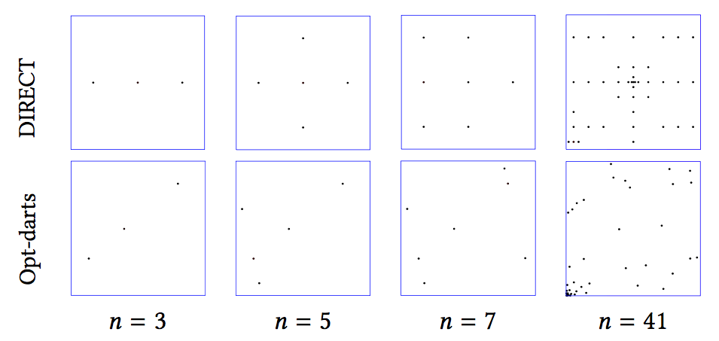
Application: Global Optimization
DIRECT = DIviding RECTangles
Divide space by rectangles
Refine large rectangles with small sample values
Opt-Darts
Divide space by Voronoi cells (implicit only)
Refine large cells with small sample values
Approx. Delaunay graph defines “large” cells
Spoke-darts selects refinement sample
Opt-Darts: 5-25× speedup over DIRECT
Increasing speedup with d
Rectangle bad approximation of Voronoi cell
More-random sample patterns

Slide 25
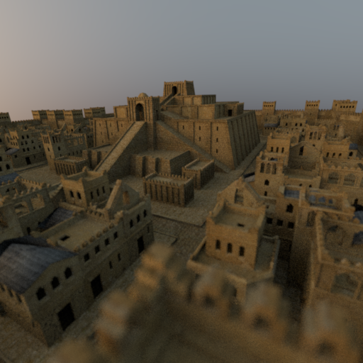

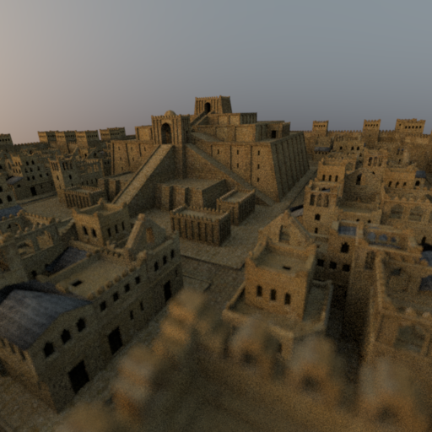
Application: Rendering
Mitsuba ray tracing
4D = 2 screen × 2 lens
16 samples per pixel
Spoke-darts comparable to alternatives
Stratified
Low discrepancy

Slide 26
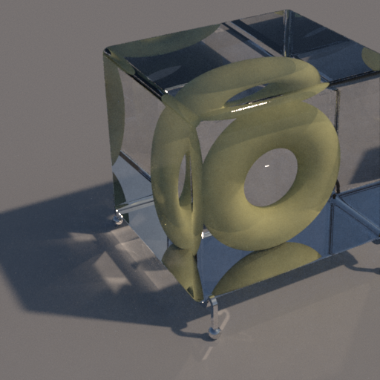
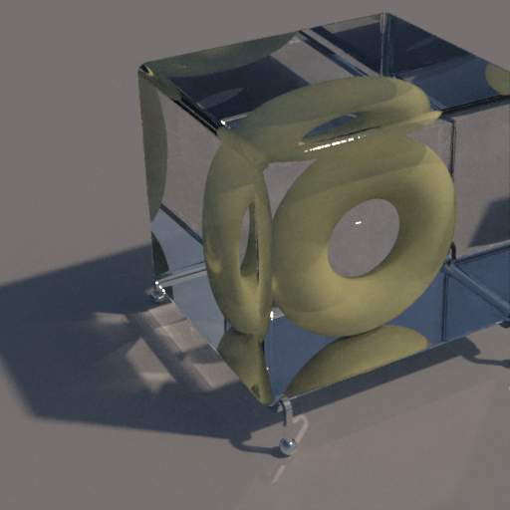

Application: Rendering
Mitsuba ray tracing
8D = 2 sky-emitter × 2 screen × 2 × 2 bounce
256 samples per pixel
Spoke-darts comparable to alternatives
Stratified
Low discrepancy

Slide 27
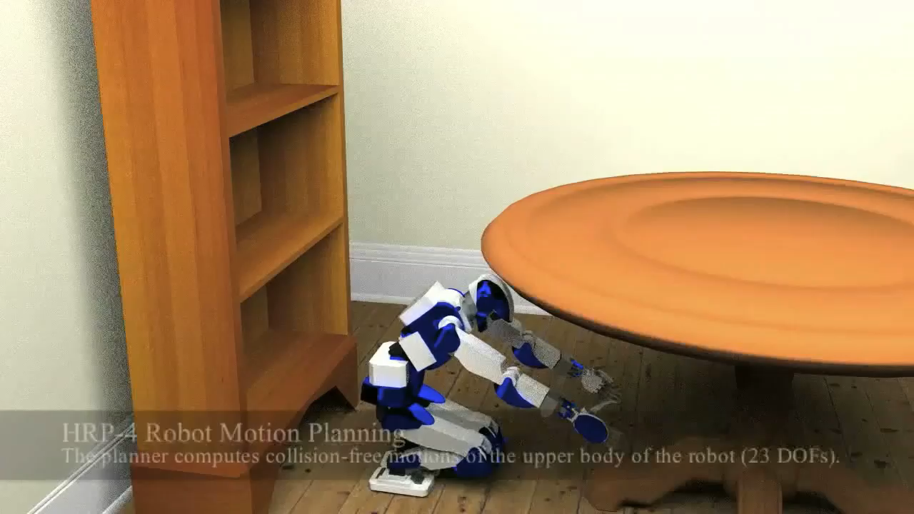
Application: Motion Planning
Path = robot: under table to up book: table to shelf
23d = degree of freedom robot
Non-uniform: joint angles and room dimensions
Pre-sample configuration space with spoke-darts
Explore paths in parallel, avoid redundant searches
Order of magnitude speedup

Slide 28

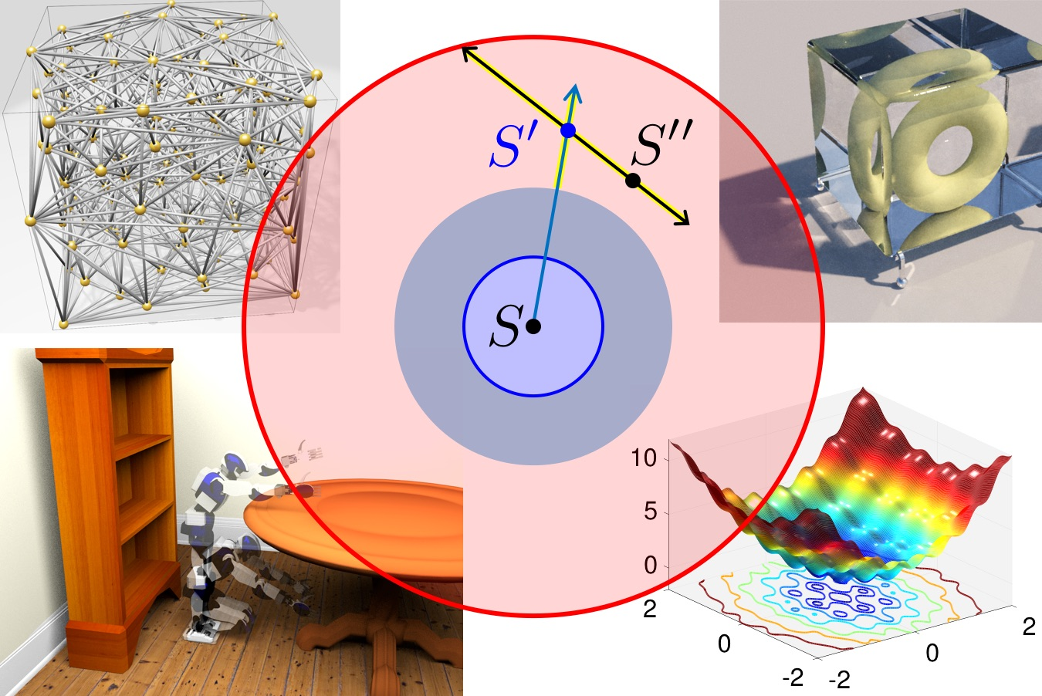
Conclusions
Free software
SpokeDartsPublic on github https://github.com/samitch/SpokeDartsPublic
Open problems
Prove non-trivial saturation-bound on Bridson 2007?
Does saturation matter for high-d rendering, etc.?
Spoke-Darts Blue-noise Linear scaling by dimension Guaranteed saturation
Geometry
Render
Two-Spokes
Better spectrum: no spike New standard for quality blue noise
Optimize
Motion Plan
Notes:
I've made the software available
Guidance
(read)
Open problems
questions?

Slide 29
Backup slides
Spoke-Darts

Slide 30
Runtime , best one can hope for
d
Linear scaling is perfect: primitives are O(d)
n²
Finding neighbors in high dimensions expensive
Each of n samples, find neighbors
Each of n may have n neighbors
Finding them quickly still won’t prevent n²
Spoke-Darts ≈ Bridson 2007 due to simple primitives
Is point in sphere
Trim segment by sphere
Runtime( Two-Spokes ) > Runtime( One-Spoke )
mostly due to 2 × radius of annulus, many more neighbor disks
Notes:
d perfect
n^2 : find if you can do neighbor finding better than brute force in d=20 ... result!
but in high-d all the points are neighbors so n^2 best you can hope for
fast - simple primitives
two-spokes expensive from large search radius

Slide 31
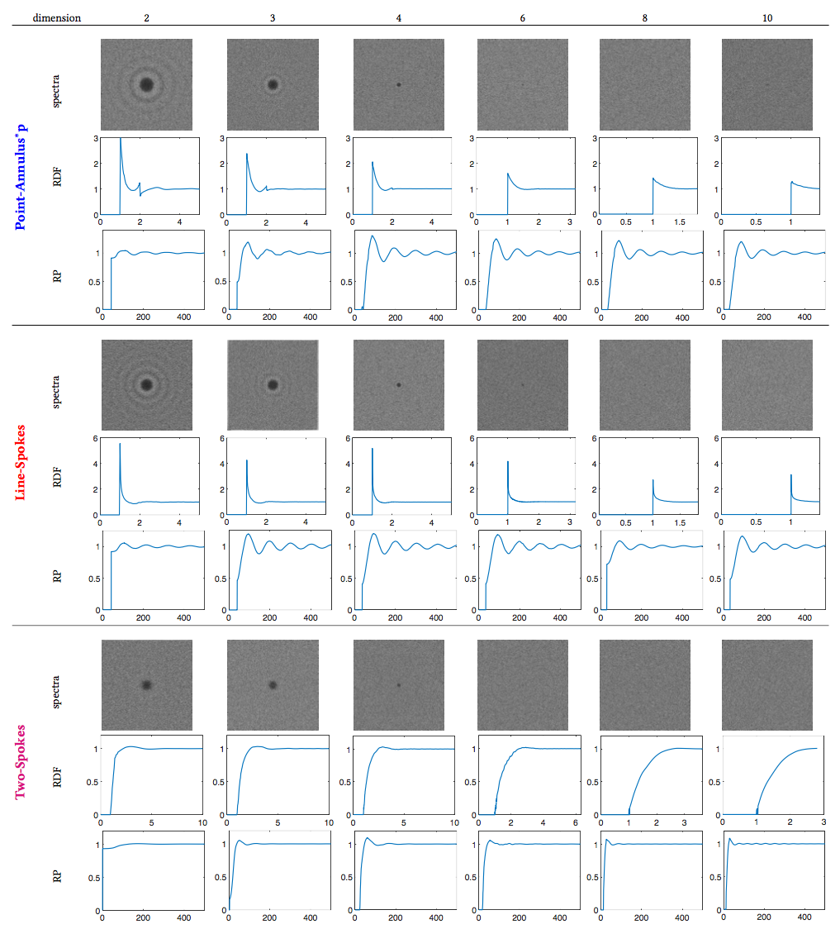
Spectra by dimension

